Slide 1

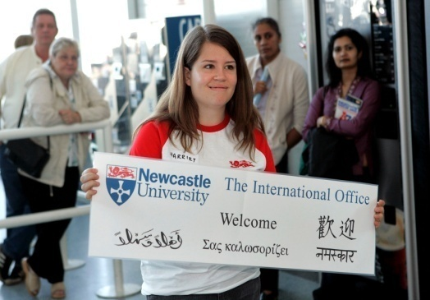
Internationalisation of HE: developing a values-based dialogue
Sue Robson
sue.robson@ncl.ac.uk
Notes:
Internationalization is one of the key contemporary debates within the Higher Education (HE) sector. While international scholarly exchange has occurred for many years, the range and complexity of international activities has increased rapidly and has become a key area of strategic focus at many universities. The economic imperatives driving university internationalization strategies are widely acknowledged. Globalisation, the knowledge economy and advances in technology have influenced and intensified the internationalisation of HE (Jiang, 2008; Altbach et al, 2009). The transformative trends for HE brought about by the recession have also created heightened international economic competition and growth in the for-profit sector (Turner and Robson, 2008; Middlehurst and Woodfield, 2007; Corbett Broad, 2012). The emphasis has shifted from internationalisation as a means to improvement in programme quality, capacity building, cooperation and partnership to an emphasis on competition, revenue generation, prestige and global rankings (http://www.eaie.org/blog/internationalisation-with-integrity/ ). As Anna said this morning, while a marketization discourse may be inevitable in the current HE funding climate, there is a danger that this may steer thinking away from the radical reassessment of HE purposes, priorities and processes that internationalization requires (de Vita and Case, 2003). After a period of intense development, perhaps internationalisation may be losing its way. At a NAFSA: Association of International Educators conference in June 2011, Jane Knight suggested that internationalisation was having an identity crisis, while Brandenburg and De Wit (2011, 2012) felt that we’d lost sight of what it was all about. So almost four years on, are we witnessing “The End of Internationalization?” (NAFSA session title) or have we regained a sense of purpose and direction? Four years on is it time to reassess further, to re consider what characterises an internationalized university.?The literature highlights the complexities, confusions and lack of consensus about the purposes of HE internationalization. Can internationalization be a transformative agenda for HE? If such a transformation is possible, what must be changed; who is affected and what are the underpinning processes involved? What are the conceptual and methodological challenges? Can the social goals of internationalisation create a set of potent heuristics for generative theorisation/ (Odora Hoppers, 2009, 206)

Slide 2
Internationalisation
pervasive but contested concept in contemporary HE, often economically driven (Turner and Robson, 2008; Tian and Lowe, 2009; Brandenburg and De Wit, 2011)
the presence of international students is often seen as a key to internationalisation (as well as having obvious commercial benefits), but the actions taken to accommodate and integrate those students are often inadequate or inappropriate. (Reid and Spencer Oatey, 2013)
a marketization discourse steers thinking away from a radical reassessment of HE purposes, priorities and processes that student diversity and multicultural interaction require (Caruana and Spurling, 2007; ; Tadaki and Tremewan, 2013)
Notes:
Over the last two decades, the concept of the internationalization of higher education has moved from the fringe of institutional interest to the very core- a quick google search reveals that many Unis worldwide proclaim their ‘international status’, but there has been little consensus about how we define that. Many UK HEIs have begun to internationalize from a business focus – focusing on recruitment of international students and staff - but how well do we support the staff and student experience once they arrive?
Technology exposes learners to multiple life-worlds and media/sources making diversity more immediate (Cope and Kalantzis, 2009). How can we support a cultural shift to develop long-term sustainability?

Slide 3

We have to ….ask ourselves: why do we do certain things and do they help in achieving the goal of quality of education and research in a globalized knowledge society? We also have to regard mobility and other activities as what they really are: activities or instruments - and therefore by definition not goals in themselves
Brandenburg and De Wit, 2011
Notes:
In ‘the End of Internationalisation’ 2011 Brandenburg and De Wit track the conceptual development of internationalisation from isolated, uncoordinated and generally low prestige international activity in the 70s and 80s, with the exception of research. In the late 80s, internationalisation began increasing in importance and diversity, moving from simple exchange of students to the big business of recruitment and from activities impacting on an incredibly small elite group to a mass phenomenon. Alongside this development came the development of globalisation- loaded with negative connotations, whereas internationalisation became the ‘white knight’ of HE leading to ‘peace, mutual understanding, justice and equity’. Yet activities more related to the concept of globalisation have increasingly been associated with internationalisation - HE as a tradable commodity - more exchange, more degree mobility, and more recruitment, losing sight of more innovative developments such as the emergence of the digital citizen. To regain the true meaning of internationalisation as a means to an end - a process, rather than a state represented by volume of international staff and students - with a common commitment at the institutional and personal level to be prepared to live and work in a global community. We cannot continue to assume that certain types of mobility and other international activities (such as exchanges and study abroad) are good in themselves and that other types (such as recruitment and transnational education) are bad. We can’t assume that the purpose of a university’s internationalization efforts is to improve global brand or standing - this confuses international marketing campaigns with internationalization plans. The former is a promotion and branding exercise; the latter is a strategy that requires us to dig deeper, place the options within a new set of values and rationales for the teaching, research, and service functions of a university’ (Knight, 2011, 15) to and ensure that we achieve something meaningful.
‘’

Slide 4
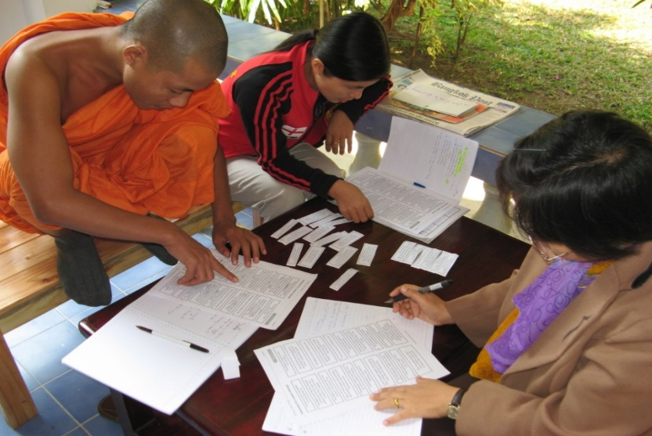
Discourses and practices of internationalisation
‘By understanding the discourses and practices of internationalization as always ‘in the making’, we can draw our attention to where and how certain ideas, projects and norms of internationalization become established, and perhaps we can expand our ability to make them differently’
Tadaki and Tremewan 2013
Notes:
From ongoing practices and rhetorics of globalization have emerged a new set of actors, logics and relations between and beyond institutions of higher education and research

Slide 5

New conceptualisations
….comprehensive internationalisation
IoC to produce graduates who can live, work and contribute as productive citizens
comparative perspectives embedded throughout the teaching, research, and service missions of HE
shapes institutional ethos and values
Hudzik, 2011
Notes:
Having noted the trends influencing internationalization in the last decade, a major challenge is evident to maintain the positive benefits of internationalization in an increasingly competitive environment. Prior to the development of education as an income-generating and prestige-seeking export industry, universities have a long history of contributing to capacity building in nation states and among students from around the globe (Sidhu and Dall’Alba 2013). Can we successfully adopt a dual role in furthering both cooperation and competition among countries, or has internationalisation become a catch phrase for ‘anything and everything remotely linked to the global, inter-cultural, or international dimensions of higher education’?(http://www.oecd.org/edu/imhe/48506334.pdf)
Hudzik (2011), past president and chair of the Board of Directors of NAFSA: Association of International Educators, Dean of International Studies and Programs and then vice president for Global Engagement and Strategic Projects at Michigan State University (MSU) suggests that universities today have to be reminded of their core mission, namely the production of graduates who can live, work and contribute as productive citizens in an increasingly fluid and borderless global context. He challenges us to think about internationalizing curriculum content (contexts, values and understandings), processes of teaching, learning and assessment, with regard for the skills and competences students (and staff) require for life and work in a diverse world. This requires commitment, confirmed through action, to infuse international and comparative perspectives throughout the teaching, research, and service missions of higher education, to shape institutional ethos and values and touch the entire higher education enterprise – a new conceptualisation Comprehensive Int’ or form of branding

Slide 6
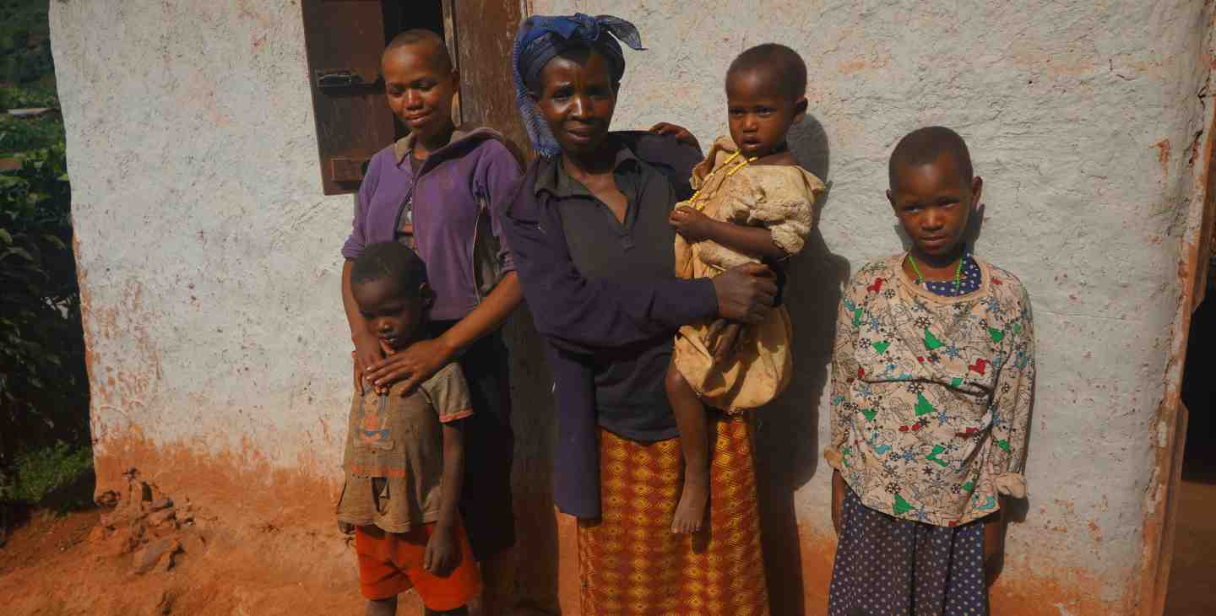
New conceptualisations
…..IoC
can foster personal transformation and global citizenship while creating bridges of understanding between local and global … issues and the increasing potential for social transformation. Hanson 2010
Notes:
Social transformation models of internationalization suggest the need for radical reform to curricula to foster engaged global citizenship, yet little is written depicting how individual courses and their instructors might support such reform (Hanson, 2010). Hanson’s 6-year outcome evaluation of the impact of two interdisciplinary global health courses taught using transformative pedagogies. The evaluation shows promise that this model of internationalized curricula can foster personal transformation and global citizenship while creating bridges of understanding between local and global health issues and the increasing potential for social transformation through the process of internationalizing curriculum. Jones and De Wit suggest that the concept of globalized internationalization requires us to: Put political and economic rationales in context by measuring the things that are important, not simply those that can be measured; learning from partners and from the diversity of policy and practice; exploit the link between international and intercultural; internationalization of curriculum, teaching, and learning at home as well as abroad as a key priority.
https://www.cfhi.org/uganda

Slide 7

New conceptualisations
an ‘international’ institution ……..
…… a place where cultures
(and so perspectives) meet
(Clifford and Montgomery, 2014)
…… enables us
to grow beyond
ourselves, rather than
constraining us within established self-views
or world views.
Killick, 2012
Notes:
Taking a model of global citizenship that is primarily a matter of seeing the self-in-the-world as one dwelling among others, Killick focuses on experiences of students with individual “significant others” and among international student communities, drawing on a 3-year study into U.K. undergraduate students participating in international mobility activities. Participants reveal how lived experience of Otherness in such intersubjective encounters enables moves to identify Self with others and to personalize hitherto distant places and practices. Even in the context of international mobility, encountering difference does not depend on the crossing of national cultures but on recognizing Otherness in all we may engage with and in ourselves. Most of the encounters in this study take place outside of the host culture or the “designed” features of the international mobility activities, suggesting opportunities for multicultural/international campuses to develop spaces for similarly rich learning for the non-mobile majority. How do we capture this/assess this/ensure that students see it as part of their ‘global passport’ into graduate careers and lives?

Slide 8

New conceptualisations: global citizenship
Key principles: participation, responsibility,
activism
Caruana in Clifford and Montgomery (Eds.) (2014); Sanda (2013)
Notes:
‘Internationalization promotes cultural diversity and fosters intercultural understanding, respect, and tolerance among peoples…and helps to build a climate of global peace’ International Association of Universities, cited in Black, 2004 –but intercultural learning doesn’t happen automatically- needs support and facilitation
So attention turns to how university staff and services can help students to negotiate cultural,
linguistic and disciplinary contexts in order to provide internationalised, transformative learning experiences for their students? IoC for global citizenship –requires opportunities to develop qualities and insights to address civic as well as economic and moral aspirations. Service learning and community volunteering as curriculum to promote participation, activism, responsibility. How to enable activism without political bias, promoting critical engagement with the conditions and lives of others? LMU to develop global perspectives through community and conservation projects offers students 4-6 week placements to enhance personal and professional development (Jones 2010)

Slide 9
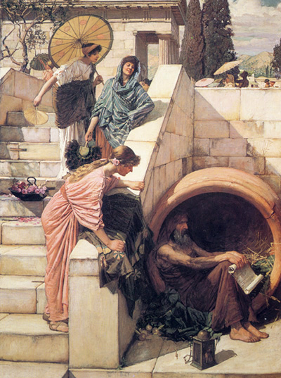
an ‘international’ institution ……
adopts cosmopolitanism as an appropriate theory to underpin student-learning frameworks ….and staff development? Lilley et al., 2014; Rizvi, 2009; Sidhu and Dall’Alba, 2012
Notes:
In terms of this cultural shift, a number of authors have recommended cosmopolitanism as an appropriate theoretical framework (Caruana, 2014; Lilley, Barker, & Harris, 2014; Marginson & Sawir, 2011; Rhoads & Szelenyi, 2011; Rizvi, 2009). Is this new thinking, or simply simply new wine in old bottles? Diogenes, when asked which country he was from, replied, ‘I am a citizen of the world’.” Diogenes (404-423 BC) . Diogenes lived in poverty, disregarding wealth and worldliness, believing that virtue could be attained by fighting hypocrisy, greed, luxury and corruption - i.e. conventional morality. He honed himself into the position of having nothing to lose but life itself. In contrast to this philosophic cosmopolitanism, Lilley et al, 2014 p17 have developed An “Identikit” of Markers for the Global Citizen ….. Leaves comfort zone Shows courage to go on a mobility experience Shows courage by taking on challenges locally Mixes beyond social peers Engages and works with different “others” Engages in learning activities “out of the comfort zone” Thinks differently Uses moral and ethical reasoning in problem solving Questions assumptions Imagines other perspectives and possibilities Shows awareness of self and others Makes the interconnections of knowledge across complex local / global constructs Recognizes common humanity and environmental sustainability
Rizvi takes thinking further by suggesting that in the context of educational practice, a reconceptualization of cosmopolitanism is required to describe ‘a mode of learning about, and ethically engaging with, new social formations’ (Rizvi, 2009, p. 243).

Slide 10
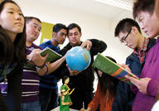
New opportunities for intercultural learning individual (micro) organisational (meso) stakeholders and society
(macro)
Otten (2009);
ECU (2010)
Deardoff (2012)
Notes:
Otten (2009) suggests work on interculturality can happen on 3 levels:

Slide 11
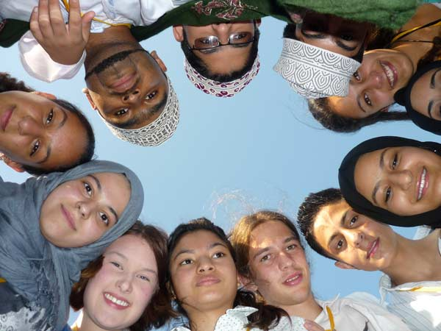
‘If we accept the notion that there are multiple ways of practising international[isation] – .... under the same mission statement – then we acknowledge that multiple worlds are already possible. However, to engage with practices (rather than just rhetorics) in a coherent way requires a kind of coordination…. or ‘convergence’ of ideas about practices…. the deliberative development of progressive narratives of practice seems to be a viable and valuable pursuit for consortia.’Tadaki and Tremewan, 2013
a focus on social, cultural and values-driven goals can lead to more acceptable conceptualisations of internationalisation, or indeed ‘create a set of potent heuristics for generative theorization’ (Odora Hoppers, 2009).

Slide 12

Internationalisation as……
creation /exchange / dissemination of knowledge
personal and professional transformations, international pedagogies
global citizenship, global connectedness, self in the world, cosmopolitanism, hospitality, agency
responsible, meaningful, comprehensive engagement
intercultural understanding, reciprocity
Research capacity-building, theorising
entrepreneurial (income generating) activities
recruitment
rankings
branding
world class research
Notes:
Jones and De Wit suggest that globalized internationalization requires us to: Put political and economic rationales in context by measuring the things that are important, not simply those that can be measured; Exploit the globalization of internationalization by learning from partners and from diversity of policy and practice; exploit the link between international and intercultural; internationalization of curriculum, teaching, and learning at home as well as abroad should be a key priority.

Slide 13
Dimensions of Internationalisation
Cultural context
people
Activity
Culture
Values
Knowledge
place
programmes
Notes:
an attempt to try to capture some of these trends and to re-frame the dimensions of internationalisation
working with the HEA to develop a values- based internationalisation framework in response to a request from the sector. The framework aims to:
provide a high quality and global learning experience for all students;
foster approaches to learning and teaching that transcend national and international boundaries;
address individual and institutional roles and responsibilities
Dimensions of policy and practice:
Demonstrable institutional commitment
Working in partnership with students
Collaboration with and engagement of all staff
Tailored to the discipline and learning context
Core purpose to develop an international culture within our institutions

Slide 14
An inclusive and globalised culture- promoting a flexible, responsive and contextualised culture, informed by global perspectives and enriched by the diversity of the student/staff body.
A global learning experience - promoting student and staff mobility, providing language and cultural emersion though working or studying overseas, to enhance learning within HE and beyond.
Intercultural values and skills - promoting the global citizenship of students and staff, developing their understanding of global diversity, cultural skills & values, to enhance their contribution to the global society.
A global academic community - promoting knowledge exchange, networking and collaboration between students and staff across the world, working together to enhance capacity, learning and society.
Global social justice - promoting an ethical approach to education, through mutual respect, reciprocity and fairness for all.

Slide 15
references
Journal of Studies in International Education
Journal of Studies in International Education
Beelen, J. and de Wit, H. (2012) Internationalisation revisited: new dimensions in the
internationalisation of HE. CAREM, Hogeschool van Amsterdam
Brandenburg, U. and (2011) The end of internationalisation. International
Higher Education 2011 Issue 62, 15-17. Centre for International Higher Education.
https://htmldbprod.bc.edu/prd/f?p=2290:4:0::NO:RP,4:P0_CONTENT_ID:113987 )
Clark, J. (2012). “Using Diamond Ranking as Visual Cues to Engage Young People in the
Research Process,” Qualitative Research Journal. 12.2: 222–237.
Clifford, V. and Montgomery, C. (2014). Challenging conceptions of Western Higher
Education and developing graduates as global citizens. Higher Education Quarterly. 68
(1), 28–45,
Hanson, L. 2010 Global Citizenship, Global Health, and the Internationalization of Curriculum: A Study of Transformative Potential. Journal of Studies in International Education, 14(1), 70-88 Higher Education Academy. https://www.heacademy.ac.uk/workstreams-research/themes/internationalisation/internationalisation-framework
Hudzik, J.K. (2011) Comprehensive Internationalization: From Concept to Action. NAFSA
Killick, D. (2012) Seeing ourselves in the world: Developing Global Citizenship through International Mobility and Campus Community. Journal of Studies in international Education, 16 (4), 372-89

Slide 16
references
Lilley, K., Barker, M., and Harris, N 2014 Exploring the Process of Global Citizen
Learning and the Student Mind-Set Journal of Studies in International Education
September 11, 2014 1028315314547822
Odora Hoppers, C.A. (2009). Education, culture and society in a globalizing world:
Implications for comparative and international education. Compare: A Journal of Comparative and International Education, 39(5), 602–614.
Reid S and Spencer Oatey H: (2013) Towards a Global Citizen: utilising a
competency framework to promote intercultural knowledge and skills in higher education students Ch.9, p 125-141 in Ryan J. Ed. (2013) Cross Cultural Teaching and Learning for Home and International Students, Routledge.
Robson S (2011) Internationalization: a transformative agenda for higher education? Teachers and Teaching, 17:6, 619-630
Rockett, M. and S. Percival. (2002). Thinking for Learning. Stafford: Network Educational Press.
Sidhu, R.K. & Dall’Alba, G. (2012) International Education and (Dis)embodied Cosmopolitans. Educational Philosophy and Theory, 44 (4), 413 -431
Tadaki, M. and Tremewan, C. (2013) Reimagining internationalization in higher education: international consortia as a transformative space? Studies in Higher Education, 38 (3), 367-387

